Slide 1
Architectural Patterns and Styles

Slide 2
What Is An Architectural Style?
An architectural style, sometimes called an architectural pattern, is a set of principles-a coarse grained pattern that provides an abstract framework for a family of systems.
An architectural style improves partitioning and promotes design reuse by providing solutions to frequently recurring problems.
Architecture styles and patterns as sets of principles that shape an application.

Slide 3
Category
Category | Architecture styles
Communication | Service-Oriented Architecture (SOA), Message Bus
Deployment | Client/Server, N-Tier, 3-Tier
Domain | Domain Driven Design
Structure | Component-Based, Object-Oriented, Layered Architecture

Slide 4
Architectural Styles
Architecture style | Description
Client/Server | Segregates the system into two applications, where the client makes requests to the server. In many cases, the server is a database with application logic represented as stored procedures.
Component-Based Architecture | Decomposes application design into reusable functional or logical components that expose well-defined communication interfaces.
Domain Driven Design | An object-oriented architectural style focused on modeling a business domain and defining business objects based on entities within the business domain.
Layered Architecture | Partitions the concerns of the application into stacked groups (layers).
Message Bus | An architecture style that prescribes use of a software system that can receive and send messages using one or more communication channels, so that applications can interact without needing to know specific details about each other.
N-Tier / 3-Tier | Segregates functionality into separate segments in much the same way as the layered style, but with each segment being a tier located on a physically separate computer.
Object-Oriented | A design paradigm based on division of responsibilities for an application or system into individual reusable and self-sufficient objects, each containing the data and the behavior relevant to the object.
Service-Oriented Architecture (SOA) | Refers to applications that expose and consume functionality as a service using contracts and messages.

Slide 5
Combining Architectural Styles
The architecture of a software system is almost never limited to a single architectural style, but is often a combination of architectural styles that make up the complete system.
A combination of architecture styles is also useful if you are building a public facing Web application, where you can achieve effective separation of concerns by using the layered architecture style. This will separate your presentation logic from your business logic and your data access logic.

Slide 6
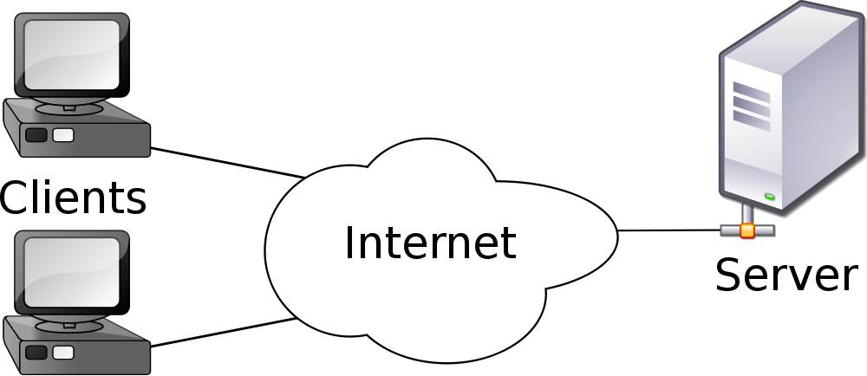
Client/Server Architectural Style
The client/server architectural style describes distributed systems that involve a separate client and server system, and a connecting network. The simplest form of client/server system involves a server application that is accessed directly by multiple clients, referred to as a 2-Tier architectural style.

Slide 7
Client/Server Architectural style (variations)
Other variations on the client/server style include:
Client-Queue-Client systems. This approach allows clients to communicate with other clients through a server-based queue. Clients can read data from and send data to a server that acts simply as a queue to store the data. This allows clients to distribute and synchronize files and information. This is sometimes known as a passive queue architecture.
Peer-to-Peer (P2P) applications. Developed from the Client-Queue-Client style, the P2P style allows the client and server to swap their roles in order to distribute and synchronize files and information across multiple clients. It extends the client/server style through multiple responses to requests, shared data, resource discovery, and resilience to removal of peers.

Slide 8
Client/Server Architectural variations
Application servers. A specialized architectural style where the server hosts and executes applications and services that a thin client accesses through a browser or specialized client installed software. An example is a client executing an application that runs on the server through a framework such as Terminal Services.

Slide 9
Client/Server Architectural variations (main benefits)
The main benefits of the client/server architectural style are:
Higher security. All data is stored on the server, which generally offers a greater control of security than client machines.
Centralized data access. Because data is stored only on the server, access and updates to the data are far easier to administer than in other architectural styles.
Ease of maintenance. Roles and responsibilities of a computing system are distributed among several servers that are known to each other through a network. This ensures that a client remains unaware and unaffected by a server repair, upgrade, or relocation.

Slide 10
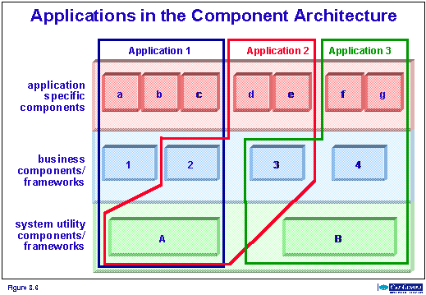
Component-Based Architectural Style
Component-based architecture describes a software engineering approach to system design and development.
It focuses on the decomposition of the design into individual functional or logical components that expose well-defined communication interfaces containing methods, events, and properties.

Slide 11
Component-Based Architectural Style (key principle)
The key principle of the component-based style is the use of components that are:
Reusable. Components are usually designed to be reused in different scenarios in different applications. However, some components may be designed for a specific task.
Replaceable. Components may be readily substituted with other similar components.
Not context specific. Components are designed to operate in different environments and contexts. Specific information, such as state data, should be passed to the component instead of being included in or accessed by the component.
Extensible. A component can be extended from existing components to provide new behavior.

Slide 12
Component-Based Architectural Style (key principle)
Encapsulated. Components expose interfaces that allow the caller to use its functionality, and do not reveal details of the internal processes or any internal variables or state.
Independent. Components are designed to have minimal dependencies on other components. Therefore components can be deployed into any appropriate environment without affecting other components or systems.

Slide 13
Component-Based Architectural Style (main benefits)
The following are the main benefits of the component-based architectural style:
Ease of deployment. As new compatible versions become available, you can replace existing versions with no impact on the other components or the system as a whole.
Reduced cost. The use of third-party components allows you to spread the cost of development and maintenance.
Ease of development. Components implement well-known interfaces to provide defined functionality, allowing development without impacting other parts of the system.

Slide 14
Component-Based Architectural Style (main benefits)
Reusable. The use of reusable components means that they can be used to spread the development and maintenance cost across several applications or systems.
Mitigation of technical complexity. Components mitigate complexity through the use of a component container and its services. Example component services include component activation, lifetime management, method queuing, even ting, and transactions.

Slide 15
Domain Driven Design Architectural Style
Domain Driven Design (DDD) is an object-oriented approach to designing software based on the business domain, its elements and behaviors, and the relationships between them.
It aims to enable software systems that are a realization of the underlying business domain by defining a domain model expressed in the language of business domain experts.
The domain model can be viewed as a framework from which solutions can then be rationalized.
.

Slide 16
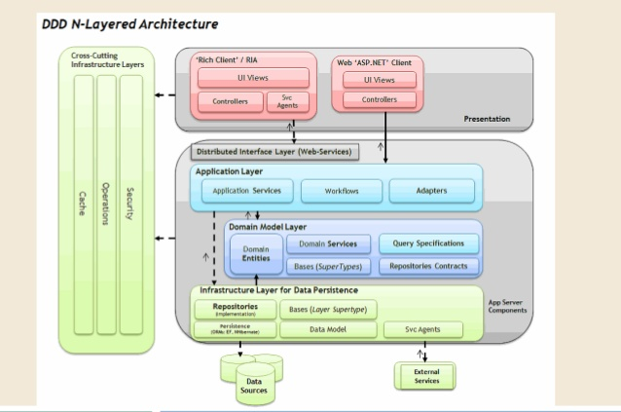
Domain Driven Design Architectural Style
To apply Domain Driven Design, you must have a good understanding of the business domain you want to model, or be skilled in acquiring such business knowledge. The development team will often work with business domain experts to model the domain.

Slide 17
Domain Driven Design Architectural Style (main benefits)
The following are the main benefits of the Domain Driven Design style:
Communication. All parties within a development team can use the domain model and the entities it defines to communicate business knowledge and requirements using a common business domain language, without requiring technical jargon.
Extensible. The domain model is often modular and flexible, making it easy to update and extend as conditions and requirements change.
Testable. The domain model objects are loosely coupled and cohesive, allowing them to be more easily tested.

Slide 18
Layered Architectural Style
Layered architecture focuses on the grouping of related functionality within an application into distinct layers that are stacked vertically on top of each other.
Functionality within each layer is related by a common role or responsibility. Communication between layers is explicit and loosely coupled.

Slide 19
Layered Architectural Style
Layering your application appropriately helps to support a strong separation of concerns that, in turn, supports flexibility and maintainability.

Slide 20
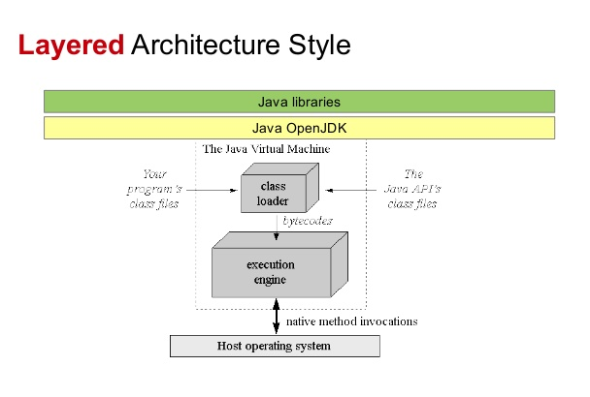
Layered Architectural Style (principles)
Common principles for designs that use the layered architectural style include:
Abstraction. Layered architecture abstracts the view of the system as whole while providing enough detail to understand the roles and responsibilities of individual layers and the relationship between them.
Encapsulation. No assumptions need to be made about data types, methods and properties, or implementation during design, as these features are not exposed at layer boundaries.

Slide 21
Layered Architectural Style (principles)
Clearly defined functional layers. The separation between functionality in each layer is clear. Upper layers such as the presentation layer send commands to lower layers, such as the business and data layers, and may react to events in these layers, allowing data to flow both up and down between the layers.
High cohesion. Well-defined responsibility boundaries for each layer, and ensuring that each layer contains functionality directly related to the tasks of that layer, will help to maximize cohesion within the layer.

Slide 22
Layered Architectural Style (principles)
Reusable. Lower layers have no dependencies on higher layers, potentially allowing them to be reusable in other scenarios.
Loose coupling. Communication between layers is based on abstraction and events to provide loose coupling between layers.

Slide 23
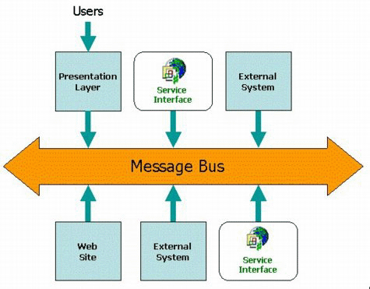
Message Bus Architectural Style
Message bus architecture describes the principle of using a software system that can receive and send messages using one or more communication channels, so that applications can interact without needing to know specific details about each other.

Slide 24
Message Bus Architectural Style
It is a style for designing applications where interaction between applications is accomplished by passing messages (usually asynchronously) over a common bus.
The most common implementations of message bus architecture use either a messaging router or a Publish/Subscribe pattern, and are often implemented using a messaging system such as Message Queuing.

Slide 25
Message Bus Architectural Style
A message bus provides the ability to handle:
Message-oriented communications. All communication between applications is based on messages that use known schemas.
Complex processing logic. Complex operations can be executed by combining a set of smaller operations, each of which supports specific tasks, as part of a multistep itinerary.

Slide 26
Message Bus Architectural Style
Modifications to processing logic. Because interaction with the bus is based on common schemas and commands, you can insert or remove applications on the bus to change the logic that is used to process messages.
Integration with different environments. By using a message-based communication model based on common standards, you can interact with applications developed for different environments, such as Microsoft .NET and Java.

Slide 27
Message Bus Architectural Style (Variations)
Variations on the message bus style include:
Enterprise Service Bus (ESB). Based on message bus designs, an ESB uses services for communication between the bus and components attached to the bus. An ESB will usually provide services that transform messages from one format to another, allowing clients that use incompatible message formats to communicate with each other
Internet Service Bus (ISB). This is similar to an enterprise service bus, but with applications hosted in the cloud instead of on an enterprise network. A core concept of ISB is the use of Uniform Resource Identifiers (URIs) and policies to control the routing of logic through applications and services in the cloud.

Slide 28
Message Bus Architectural Style (main benefits)
The main benefits of the message-bus architectural style are:
Extensibility. Applications can be added to or removed from the bus without having an impact on the existing applications.
Low complexity. Application complexity is reduced because each application only needs to know how to communicate with the bus.

Slide 29
Message Bus Architectural Style (main benefits)
Flexibility. The set of applications that make up a complex process, or the communication patterns between applications, can be changed easily to match changes in business or user requirements, simply through changes to the configuration or parameters that control routing.
Loose coupling. As long as applications expose a suitable interface for communication with the message bus, there is no dependency on the application itself, allowing changes, updates, and replacements that expose the same interface.

Slide 30
Message Bus Architectural Style (main benefits)
Scalability. Multiple instances of the same application can be attached to the bus in order to handle multiple requests at the same time.
Application simplicity. Although a message bus implementation adds complexity to the infrastructure, each application needs to support only a single connection to the message bus instead of multiple connections to other applications.

Slide 31
N-Tier / 3-Tier Architectural Style
N-tier and 3-tier are architectural deployment styles that describe the separation of functionality into segments in much the same way as the layered style, but with each segment being a tier that can be located on a physically separate computer.
They evolved through the component-oriented approach, generally using platform specific methods for communication instead of a message-based approach.

Slide 32
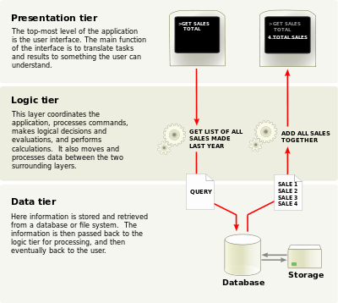
N-Tier / 3-Tier Architectural Style
N-tier application architecture is characterized by the functional decomposition of applications, service components, and their distributed deployment, providing improved scalability, availability, manageability, and resource utilization.

Slide 33
N-Tier / 3-Tier Architectural Style (main benefits)
The main benefits of the N-tier/3-tier architectural style are:
Maintainability. Because each tier is independent of the other tiers, updates or changes can be carried out without affecting the application as a whole.
Scalability. Because tiers are based on the deployment of layers, scaling out an application is reasonably straightforward.
Flexibility. Because each tier can be managed or scaled independently, flexibility is increased.
Availability. Applications can exploit the modular architecture of enabling systems using easily scalable components, which increases availability.

Slide 34
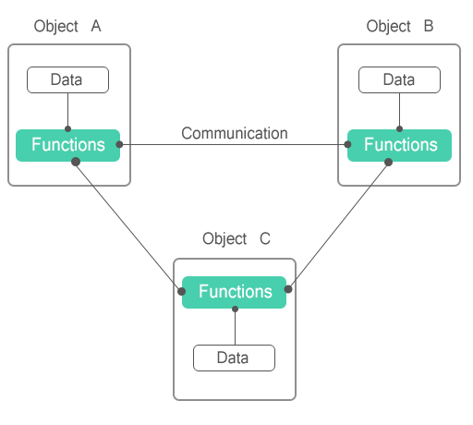
Object-Oriented Architectural Style
Object-oriented architecture is a design paradigm based on the division of responsibilities for an application or system into individual reusable and self-sufficient objects, each containing the data and the behavior relevant to the object.

Slide 35
Object-Oriented Architectural Style
An object-oriented design views a system as a series of cooperating objects, instead of a set of routines or procedural instructions.
Objects are discrete, independent, and loosely coupled; they communicate through interfaces, by calling methods or accessing properties in other objects, and by sending and receiving messages.

Slide 36
Object-Oriented Architectural Style (key principles)
The key principles of the object-oriented architectural style are:
Abstraction. This allows you to reduce a complex operation into a generalization that retains the base characteristics of the operation. For example, an abstract interface can be a well-known definition that supports data access operations using simple methods such as Get and Update. Another form of abstraction could be metadata used to provide a mapping between two formats that hold structured data.
Composition. Objects can be assembled from other objects, and can choose to hide these internal objects from other classes or expose them as simple interfaces.

Slide 37
Object-Oriented Architectural Style (key principles)
Inheritance. Objects can inherit from other objects, and use functionality in the base object or override it to implement new behavior. Moreover, inheritance makes maintenance and updates easier, as changes to the base object are propagated automatically to the inheriting objects.
Encapsulation. Objects expose functionality only through methods, properties, and events, and hide the internal details such as state and variables from other objects. This makes it easier to update or replace objects, as long as their interfaces are compatible, without affecting other objects and code.

Slide 38
Object-Oriented Architectural Style (key principles)
Polymorphism. This allows you to override the behavior of a base type that supports operations in your application by implementing new types that are interchangeable with the existing object.
Decoupling. Objects can be decoupled from the consumer by defining an abstract interface that the object implements and the consumer can understand. This allows you to provide alternative implementations without affecting consumers of the interface.

Slide 39
Object-Oriented Architectural Style (main benefits)
The main benefits of the object-oriented architectural style are that it is:
Understandable. It maps the application more closely to the real world objects, making it more understandable.
Reusable. It provides for reusability through polymorphism and abstraction.

Slide 40
Object-Oriented Architectural Style (main benefits)
Testable. It provides for improved testability through encapsulation.
Extensible. Encapsulation, polymorphism, and abstraction ensure that a change in the representation of data does not affect the interfaces that the object exposes, which would limit the capability to communicate and interact with other objects.
Highly Cohesive. By locating only related methods and features in an object, and using different objects for different sets of features, you can achieve a high level of cohesion.

Slide 41
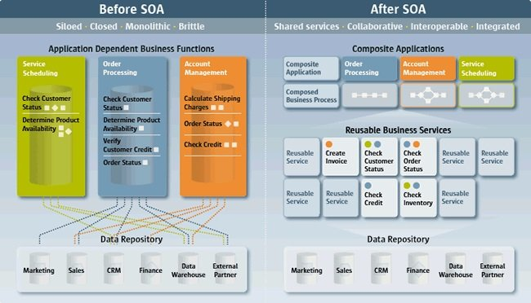
Service-Oriented Architectural Style
Service-oriented architecture (SOA) enables application functionality to be provided as a set of services, and the creation of applications that make use of software services.
Services are loosely coupled because they use standards-based interfaces that can be invoked, published, and discovered.

Slide 42
Service-Oriented Architectural Style
Services in SOA are focused on providing a schema and message-based interaction with an application through interfaces that are application scoped, and not component or object-based.
An SOA service should not be treated as a component-based service provider.

Slide 43
Service-Oriented Architectural Style (principles)
The key principles of the SOA architectural style are:
Services are autonomous. Each service is maintained, developed, deployed, and versioned independently.
Services are distributable. Services can be located anywhere on a network, locally or remotely, as long as the network supports the required communication protocols.

Slide 44
Service-Oriented Architectural Style (principles)
Services are loosely coupled. Each service is independent of others, and can be replaced or updated without breaking applications that use it as long as the interface is still compatible.
Services share schema and contract, not class. Services share contracts and schemas when they communicate, not internal classes.
Compatibility is based on policy. Policy in this case means definition of features such as transport, protocol, and security.

Slide 45
Service-Oriented Architectural Style (main benefit)
The main benefits of the SOA architectural style are:
Domain alignment. Reuse of common services with standard interfaces increases business and technology opportunities and reduces cost.
Abstraction. Services are autonomous and accessed through a formal contract, which provides loose coupling and abstraction.

Slide 46
Service-Oriented Architectural Style (main benefit)
Discoverability. Services can expose descriptions that allow other applications and services to locate them and automatically determine the interface.
Interoperability. Because the protocols and data formats are based on industry standards, the provider and consumer of the service can be built and deployed on different platforms.
Rationalization. Services can be granular in order to provide specific functionality, rather than duplicating the functionality in number of applications, which removes duplication.

